Slide 1
DNA Miracles奇妙嬰兒誕生 DNA is Born
Emmy Yeung
產品拓展助理經理Assistant Product Manager

Slide 2
奇妙嬰兒天然系列

Slide 3
2011年
全球嬰幼護理市場規模達…
IN 2011,
THE GLOBAL BABY CARE MARKET WAS WORTH…

Slide 4
2011年
全球嬰幼護理市場規模達…
$44,000,000,000
440億美元
IN 2011,
THE GLOBAL BABY CARE MARKET WAS WORTH…
$44,000,000,000
FORTY-FOUR BILLION DOLLARS

Slide 5
今日
全球嬰幼護理市場規模達…
TODAY,
THE GLOBAL BABY CARE MARKET IS WORTH…

Slide 6
今日
全球嬰幼護理市場規模達…
$52,000,000,000
520億美元
TODAY,
THE GLOBAL BABY CARE MARKET IS WORTH…
$52,000,000,000
FIFTY-TWO BILLION DOLLARS

Slide 7
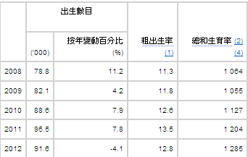
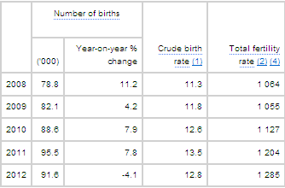
香港健康數字一覽
Health Facts of Hong Kong

Slide 8
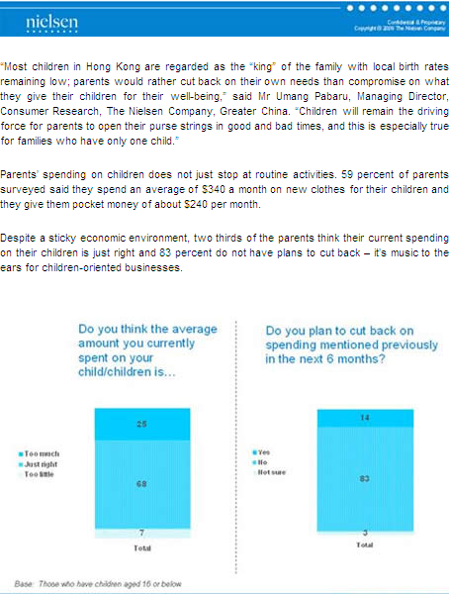
http://hk.nielsen.com/news/20090819.shtml

Slide 9
奇妙嬰兒天然系列

Slide 10
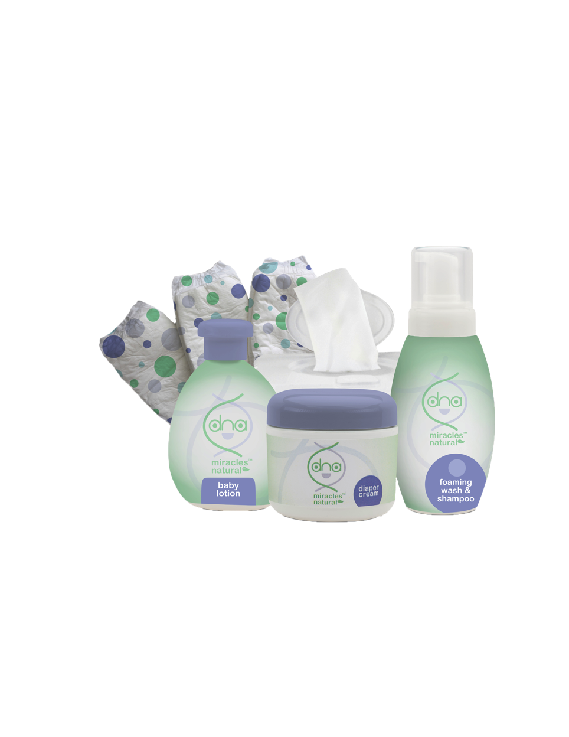

Slide 11
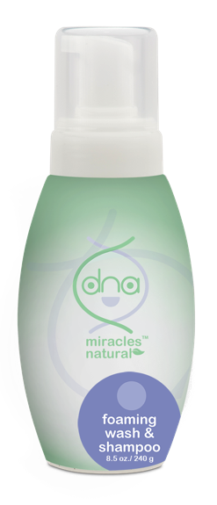
奇妙嬰兒天然洗髮沐浴泡泡
DNA Miracles Natural Foaming Wash & Shampoo
DNA Miracles Natural奇妙嬰兒天然洗髮沐浴泡泡是天然、溫和、無毒性的沐浴露，專為嬰兒細緻的皮膚和頭髮而設，適合初生嬰兒使用
含有以椰子油製造的界面活性劑，能溫和潔淨皮膚與頭髮
滋潤並調理寶寶的頭髮
DNA Miracles Natural Foaming Wash & Shampoo is a natural, gentle, non-toxic body cleanser specially formulated for your baby's delicate skin and hair. Suitable for newborn use.
Gently cleanses the skin and hair with surfactants derived from coconut oil
Moisturize and conditions your baby’s hair
HK6932 | DC $81.00 | SR $113.00 | BV 6

Slide 12
奇妙嬰兒天然洗髮沐浴泡泡
DNA Miracles Natural Foaming Wash & Shampoo
主要成份：
溫和界面活性劑
泛醇
Key Ingredients:
Gentle Surfactants
Panthenol
HK6932 | DC $81.00 | SR $113.00 | BV 6

Slide 13
奇妙嬰兒天然洗髮沐浴泡泡
DNA Miracles Natural Foaming Wash & Shampoo
使用方法
擠壓適量在手、毛巾或海綿上，或直接倒入沐浴用水中，清潔寶寶的皮膚和頭髮，然後用清水沖洗
可用於寶寶身體各處，包括面部、頭髮和身體
Direction of Use
Pour a few squirts into your hand, onto a wash cloth, onto a sponge or directly into the bath. Wash baby's wet skin and hair then rinse
Formulated to be used on all parts of your baby including face, hair and skin
HK6932 | DC $81.00 | SR $113.00 | BV 6

Slide 14
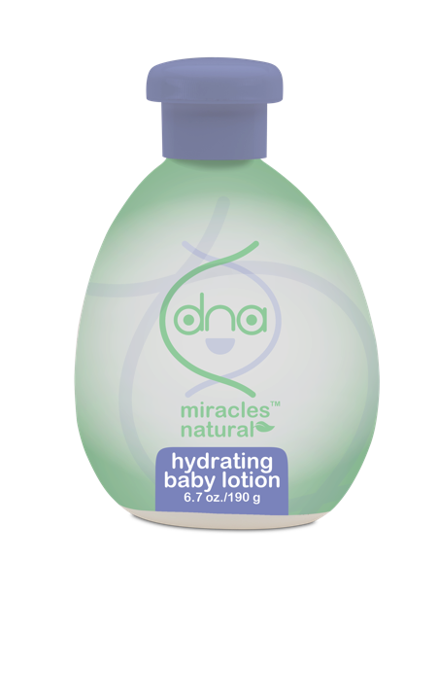
奇妙嬰兒天然潤膚乳液
DNA Miracles Natural Hydrating Baby Lotion
DNA Miracles Natural奇妙嬰兒天然潤膚乳液是天然、無毒性的潤膚乳液，專為嬰兒敏感的面部與身體肌膚而設；性質溫和，適合初生嬰兒使用，能幫助滋潤和紓緩寶寶的肌膚。
內含多種潤膚成份與草本植物萃取物，能為肌膚保濕，讓肌膚外表與觸感更細滑柔嫩
支援肌膚的正常防護功能，幫助肌膚保濕
有助紓緩肌膚輕微刺激
DNA Miracles Natural Hydrating Baby Lotion is a natural, non-toxic body lotion specially formulated for your baby's face and body. Gentle on baby's sensitive skin and suitable for newborn use; this lotion helps moisturize and soothe your baby's skin.
Moisturizes with a combination of emollients and herbal extracts for skin that looks and feels smoother and softer
Supports normal skin barrier functions to help keep the skin hydrated
Helps soothe minor skin irritations
HK6930 | DC $81.00 | SR $113.00 | BV 5.5

Slide 15
奇妙嬰兒天然潤膚乳液
DNA Miracles Natural Hydrating Baby Lotion
主要成份：
甘油
柳草花／葉／莖萃取物
泛醇
蘆薈葉汁
玻尿酸鈉
Key Ingredients:
Glycerin
Epilobium angustifolium (Willowherb) Flower / Leaf / Stem Extract
Panthenol
Aloe barbadensis (Aloe Vera) Leaf Juice
Sodium Hyaluronate
HK6930 | DC $81.00 | SR $113.00 | BV 5.5

Slide 16
奇妙嬰兒天然潤膚乳液
DNA Miracles Natural Hydrating Baby Lotion
使用方法
可在沐浴後或任何時間使用，以達到鎖水目的
支援肌膚的正常防護功能，幫助肌膚保濕
有助紓緩肌膚輕微刺激
Direction of Use
Can be applied after the bath or at any time of the day to lock in moisture
Supports normal skin barrier functions to help keep the skin hydrated
Helps soothe minor skin irritations
HK6930 | DC $81.00 | SR $113.00 | BV 5.5

Slide 17
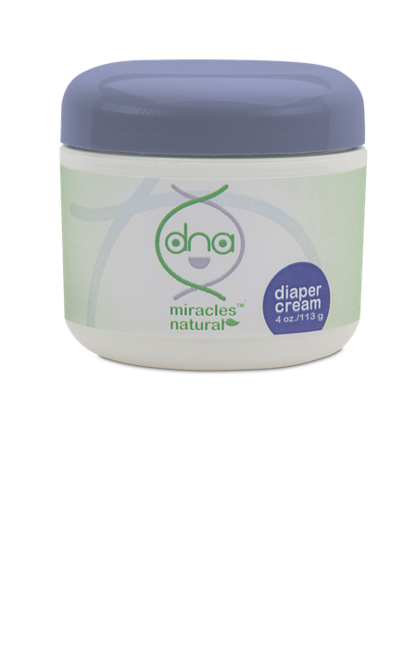
奇妙嬰兒天然抗敏護膚膏
DNA Miracles Natural Diaper Cream
DNA Miracles Natural奇妙嬰兒天然抗敏護膚膏是天然、無毒性的護膚膏，專為滋潤、紓緩和保護寶寶較敏感部位的肌膚而設。此產品有助隔絕濕氣，防止皮膚受刺激，令寶寶的皮膚柔嫩細滑
有助防止輕微的皮膚刺激，令寶寶的皮膚柔嫩細滑
有助保濕、紓緩和保護寶寶的敏感肌膚
支援肌膚的正常防護功能，幫助肌膚保濕
DNA Miracles Natural Diaper Cream is a natural, non-toxic cream specially formulated to moisturize, soothe and protect your baby’s sensitive areas. This cream helps seal out wetness and insulate against irritation to keep your baby’s skin soft and smooth-looking
Helps insulate against minor skin irritation to keep your baby’s skin soft and smooth
Helps moisturize, soothe and protect your baby’s sensitive areas
Supports normal skin barrier functions to help keep the skin hydrated
HK6931 | DC $89.00 | SR $125.00 | BV 7.5

Slide 18
奇妙嬰兒天然抗敏護膚膏
DNA Miracles Natural Diaper Cream
主要成份：
氧化鋅
甘油
柳草花／葉／莖萃取物
泛醇
尿囊素
蘆薈葉汁
Key Ingredients:
Zinc Oxide
Glycerin
Epilobium angustifolium (Willowherb) Flower / Leaf / Stem Extract
Panthenol
Allantoin
Aloe barbadensis Leaf Juice

Slide 19
奇妙嬰兒天然抗敏護膚膏
DNA Miracles Natural Diaper Cream
長時間接觸大小便、進食新的食物、尿片過緊引致摩擦等因素都會導致輕微的皮膚刺激
使用方法
可按需要於每次換尿片時使用
首先以溫和的濕紙巾或以溫水沾濕的毛巾清潔尿片包裹的部位。確保皮膚已經拍乾，才使用護膚膏
Minor skin irritation can occur from time to time as a result of prolonged exposure to urine and feces, introduction of new foods, rubbing from diapers that are too tight, and more
Direction of Use
Should be used at every diaper change as needed
First, gently clean the affected area with mild wipes or a warm wet washcloth. Make sure the affected area is dry before applying the diaper cream.
HK6931 | DC $89.00 | SR $125.00 | BV 7.5

Slide 20
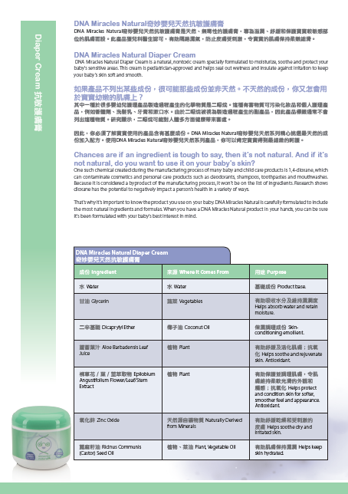
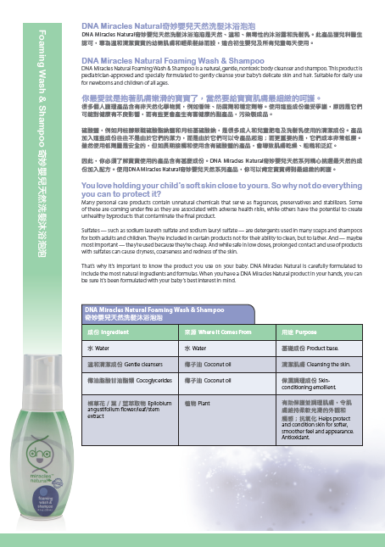
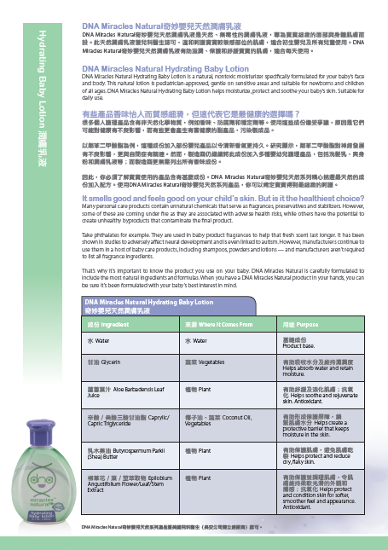
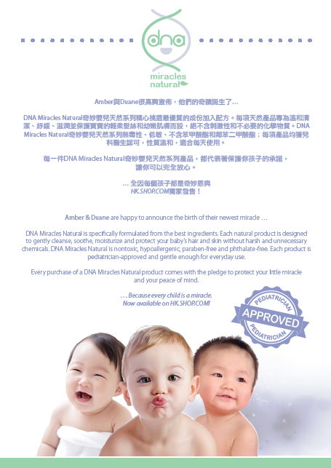

Slide 21
Dr. Mark Lang, N.D.
美安集團品質管制總監
化學科學學士
分析化學博士
營養醫學發展協會(Institute for Nutraceutical Advancement)前科學總監
擁有兩項專利及多份同業評核電化學和植物化學研究文章
Director of Quality Control for Market America
Bachelor of Science in Chemistry
PhD in Analytical Chemistry
Former Scientific Director at the Institute for Nutraceutical Advancement
Holds two patents and several peer-reviewed research articles in electrochemistry and plant chemistry.

Slide 22
Dr Lange’s Clip

Slide 23
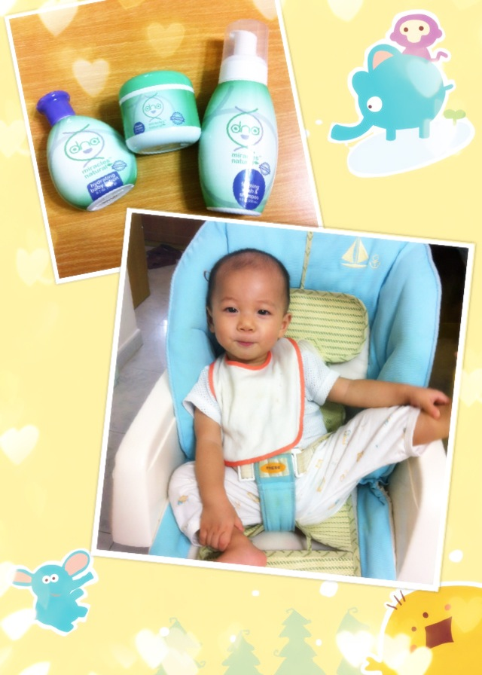
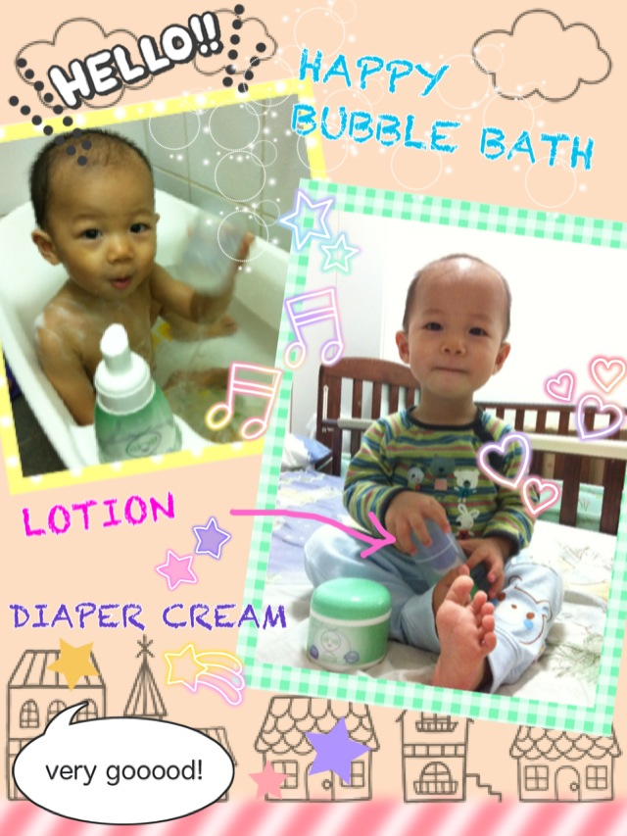

Slide 24
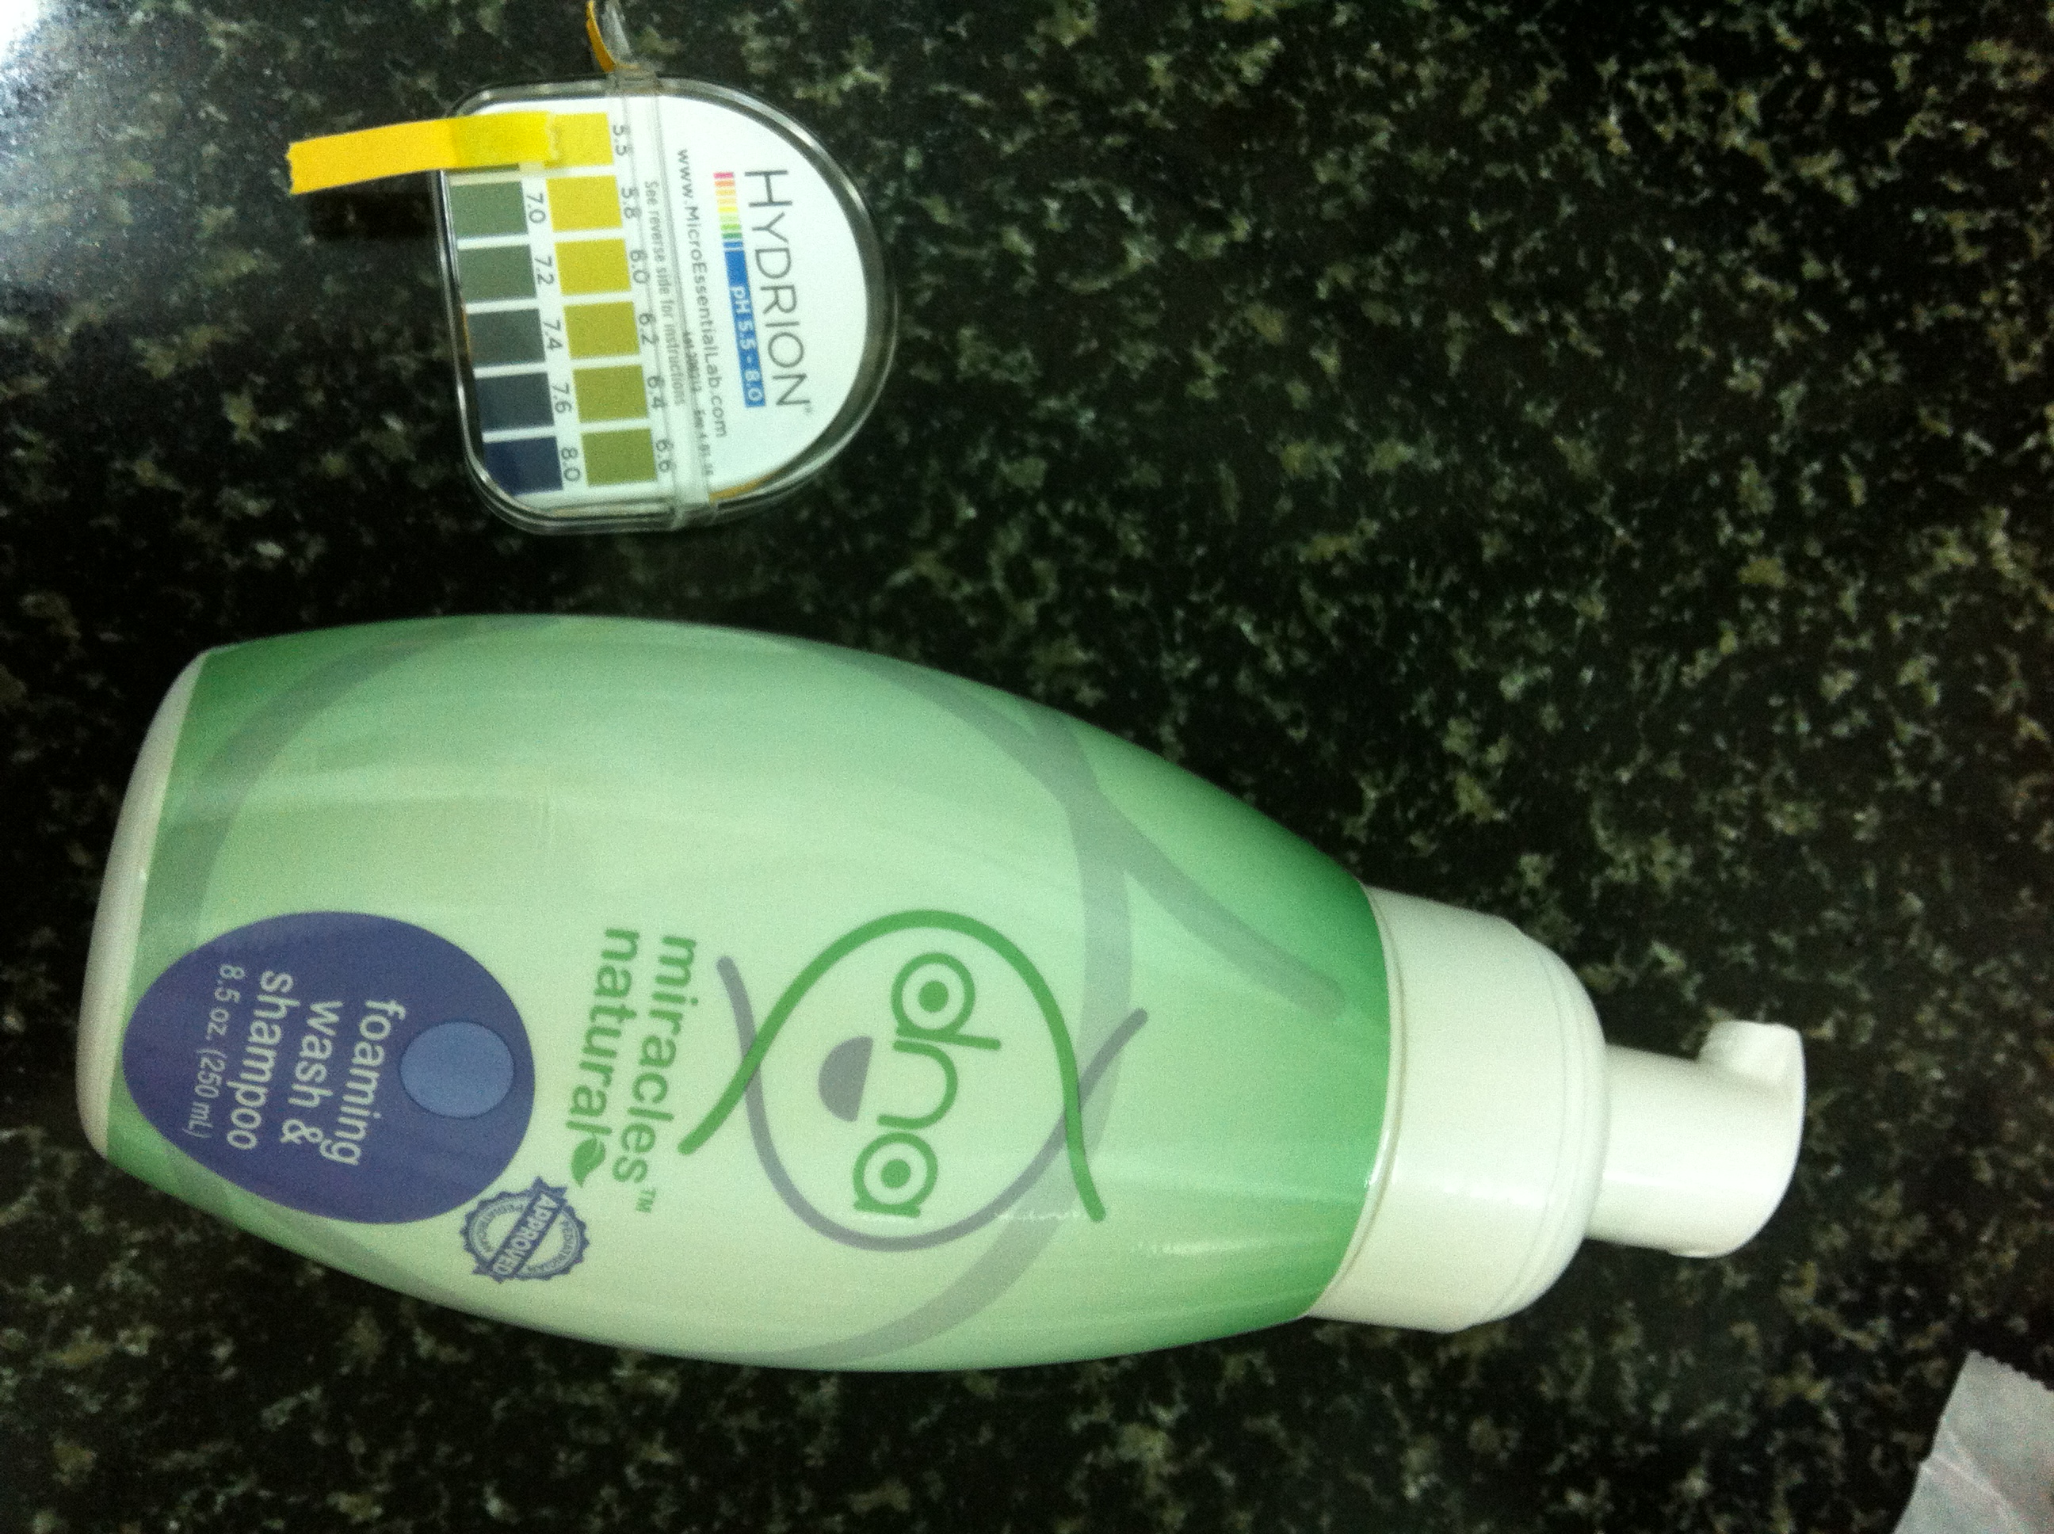

Slide 25
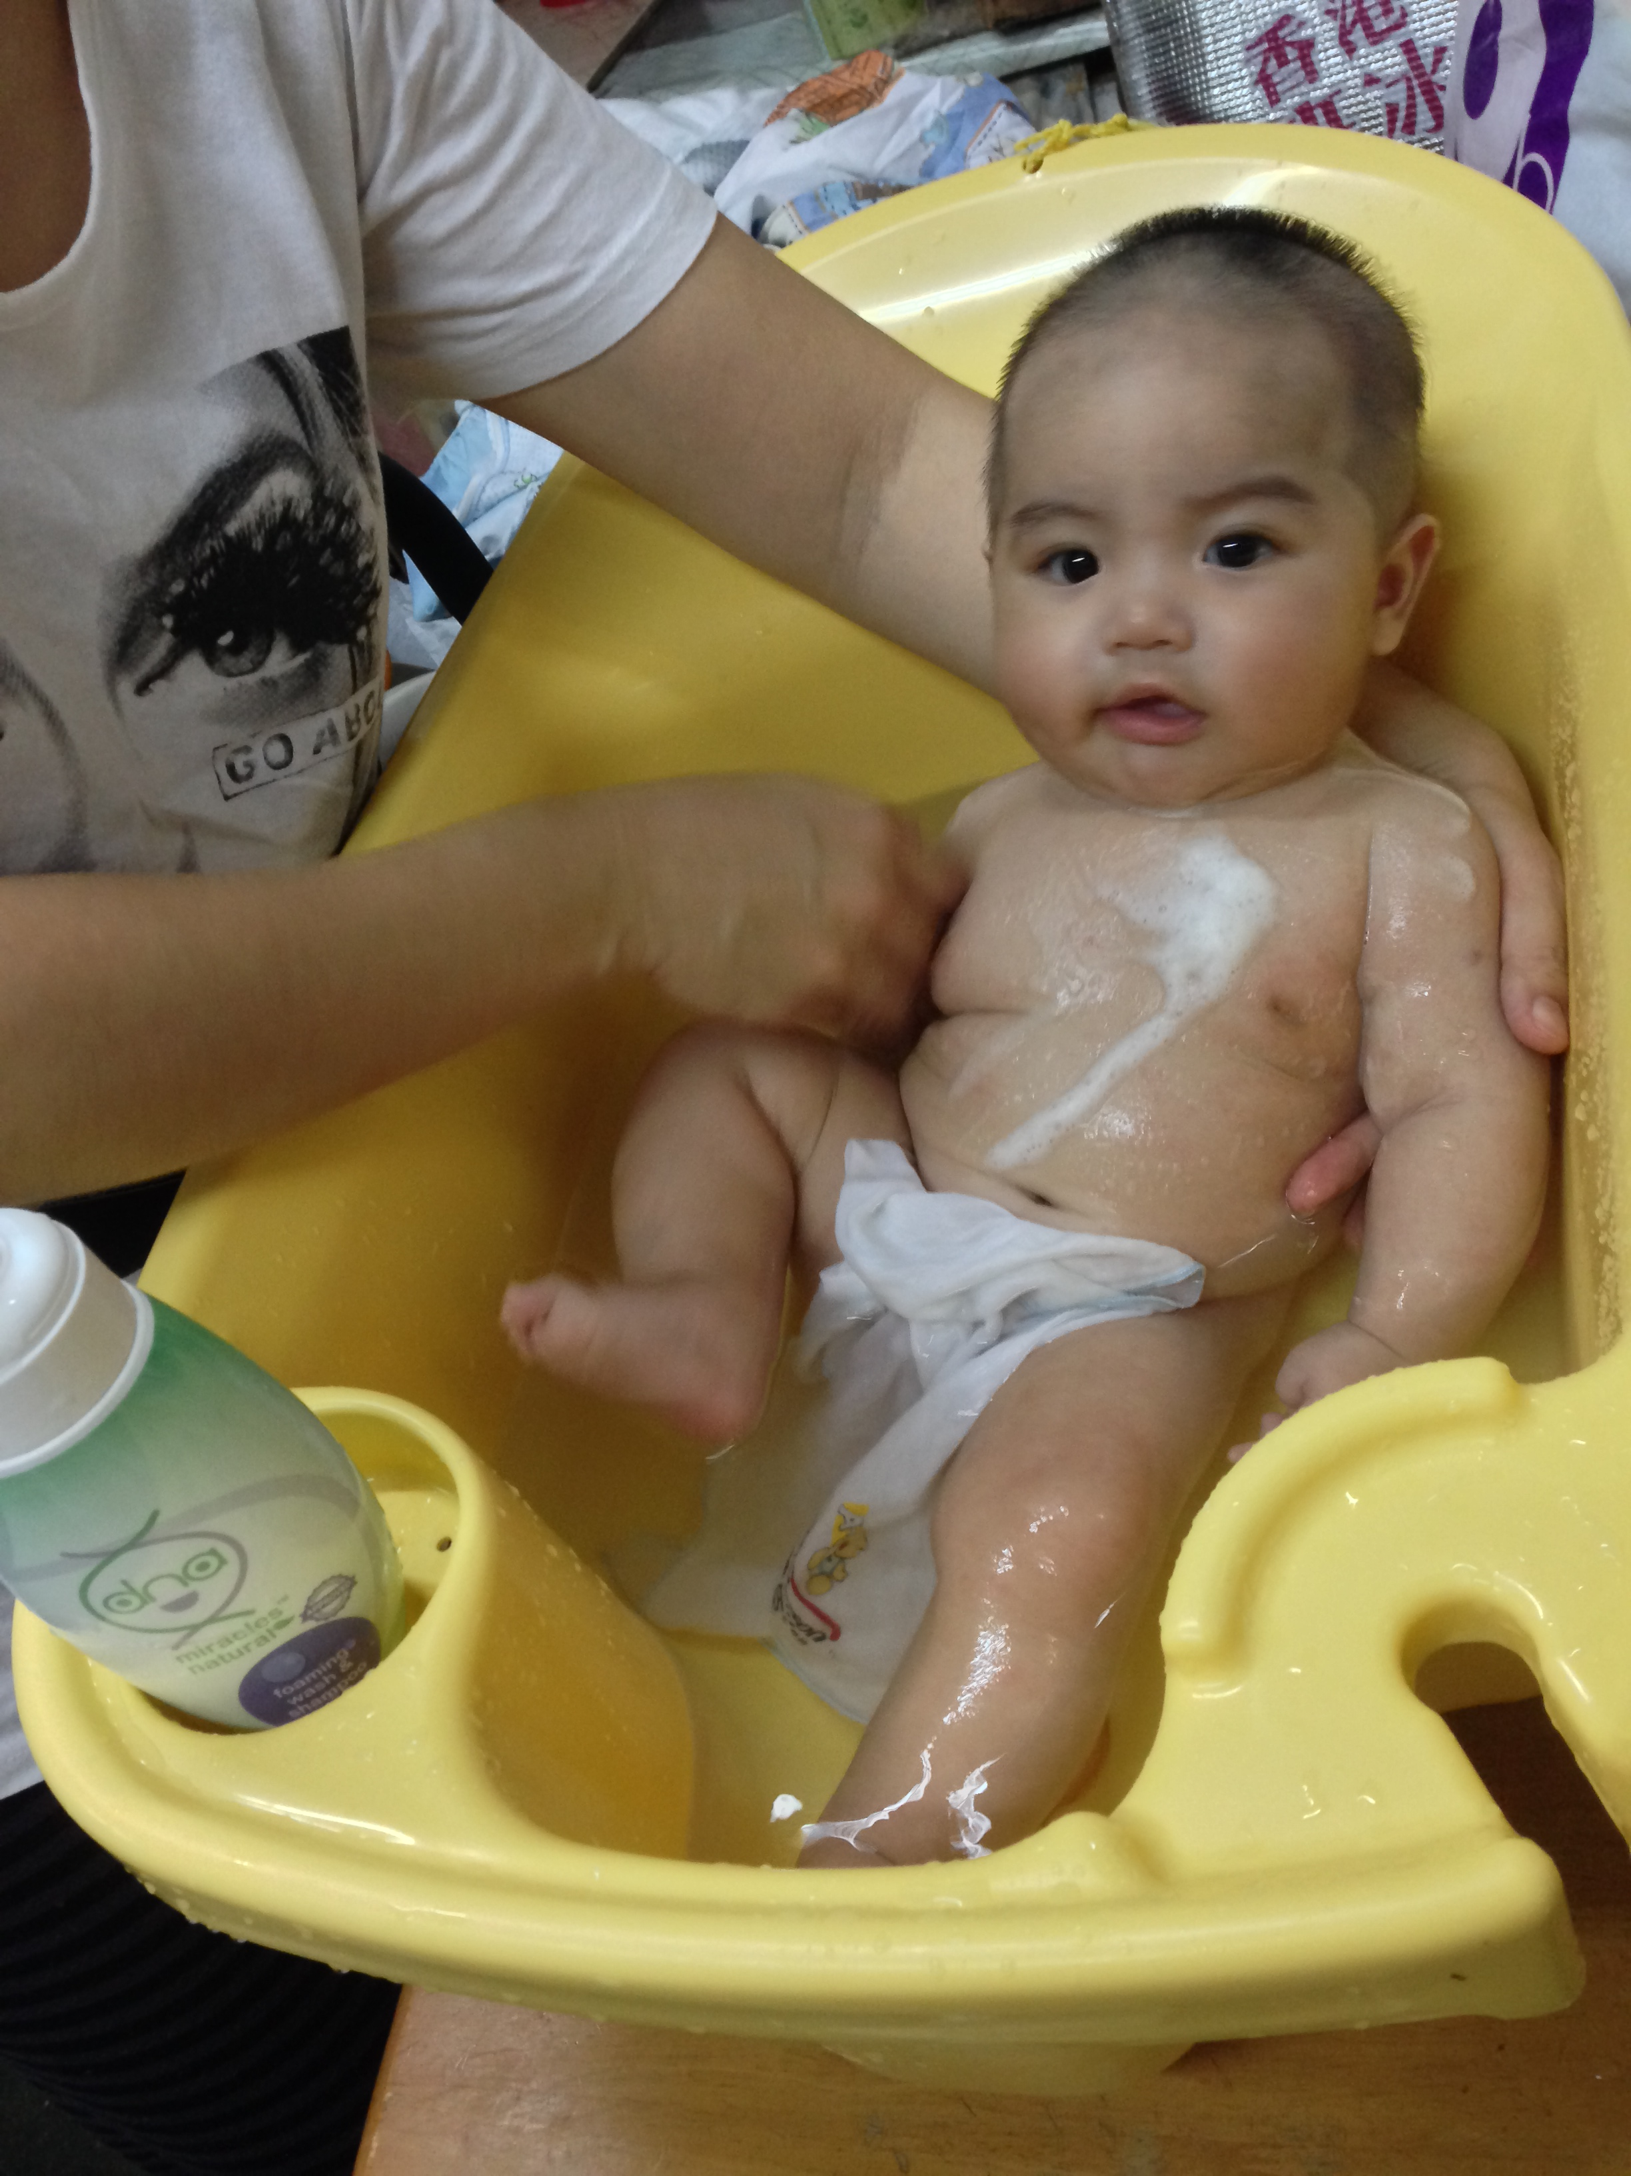
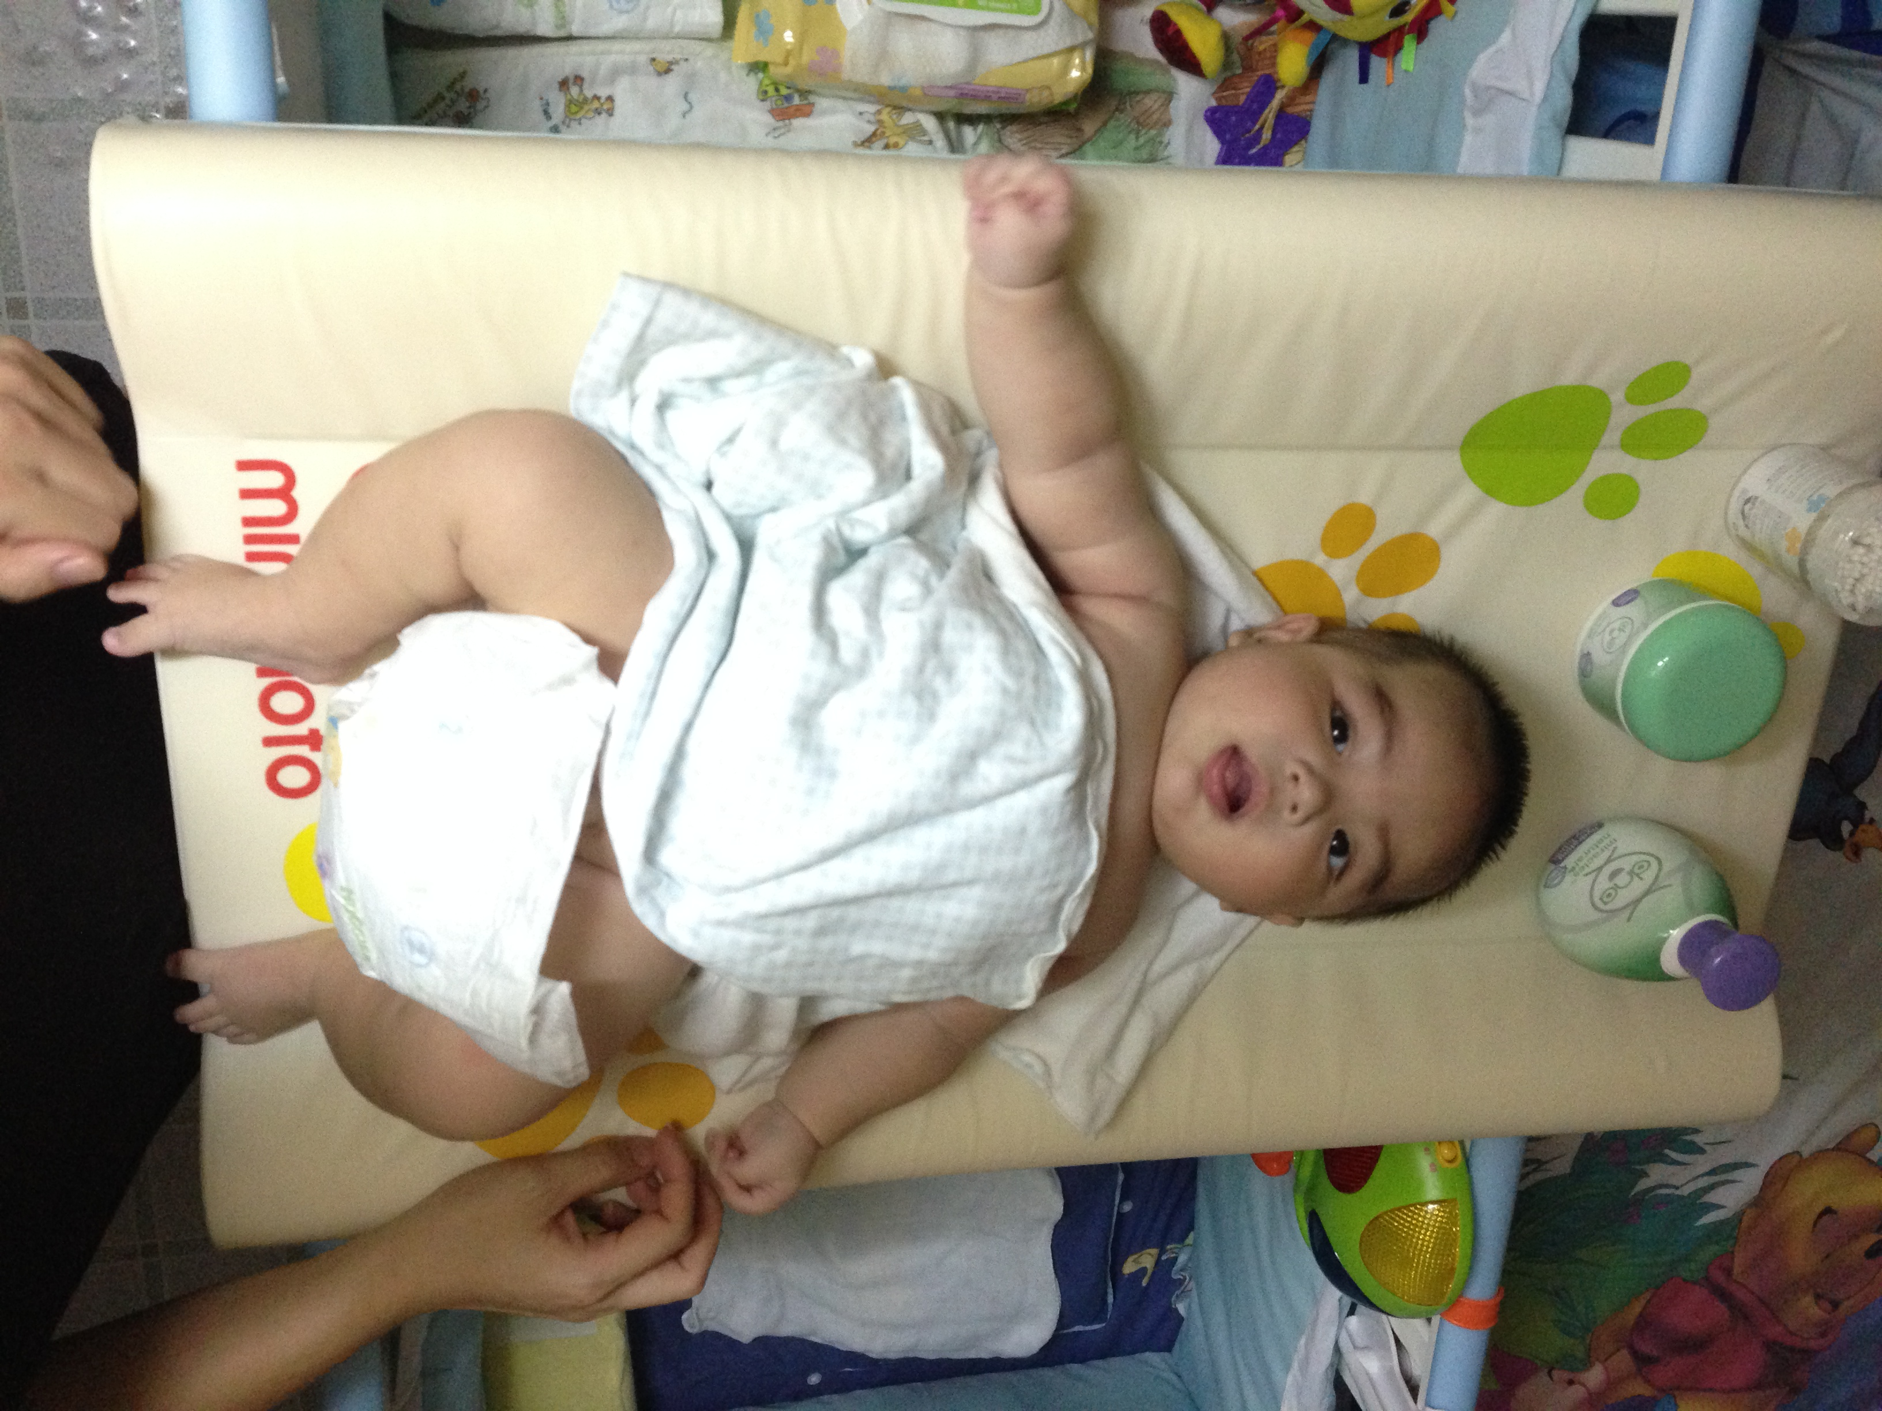

Slide 26
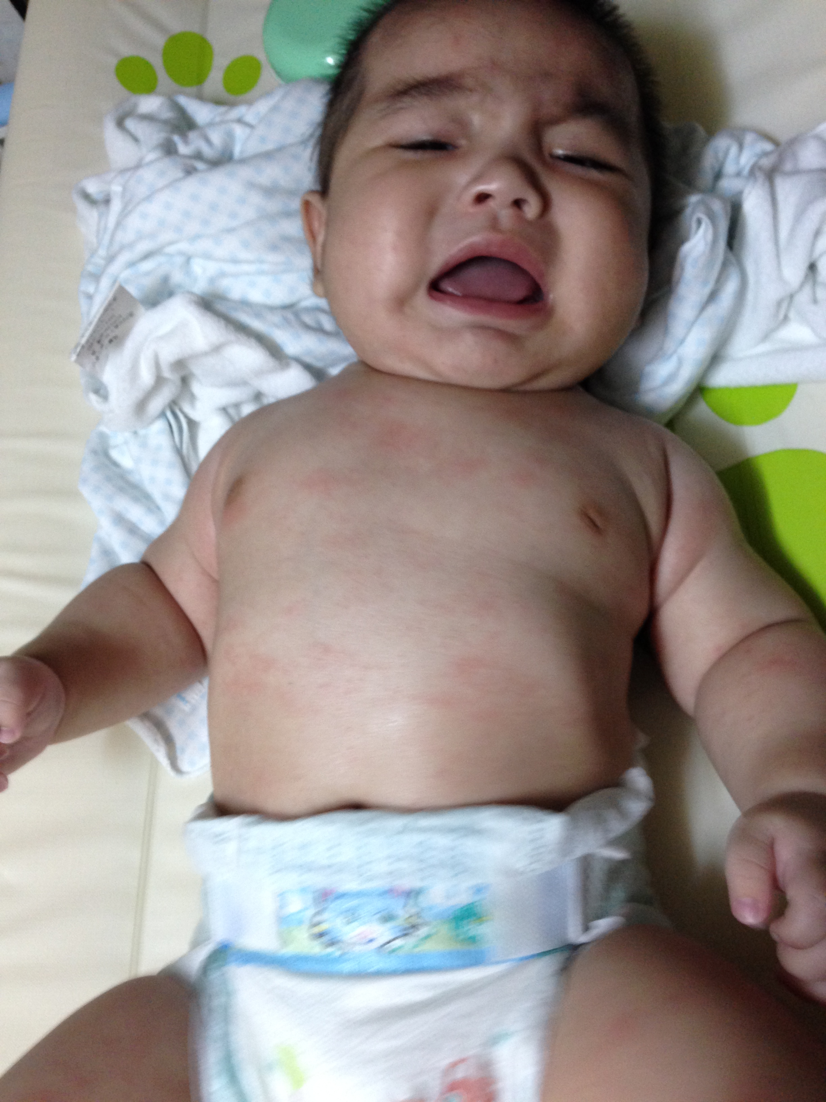
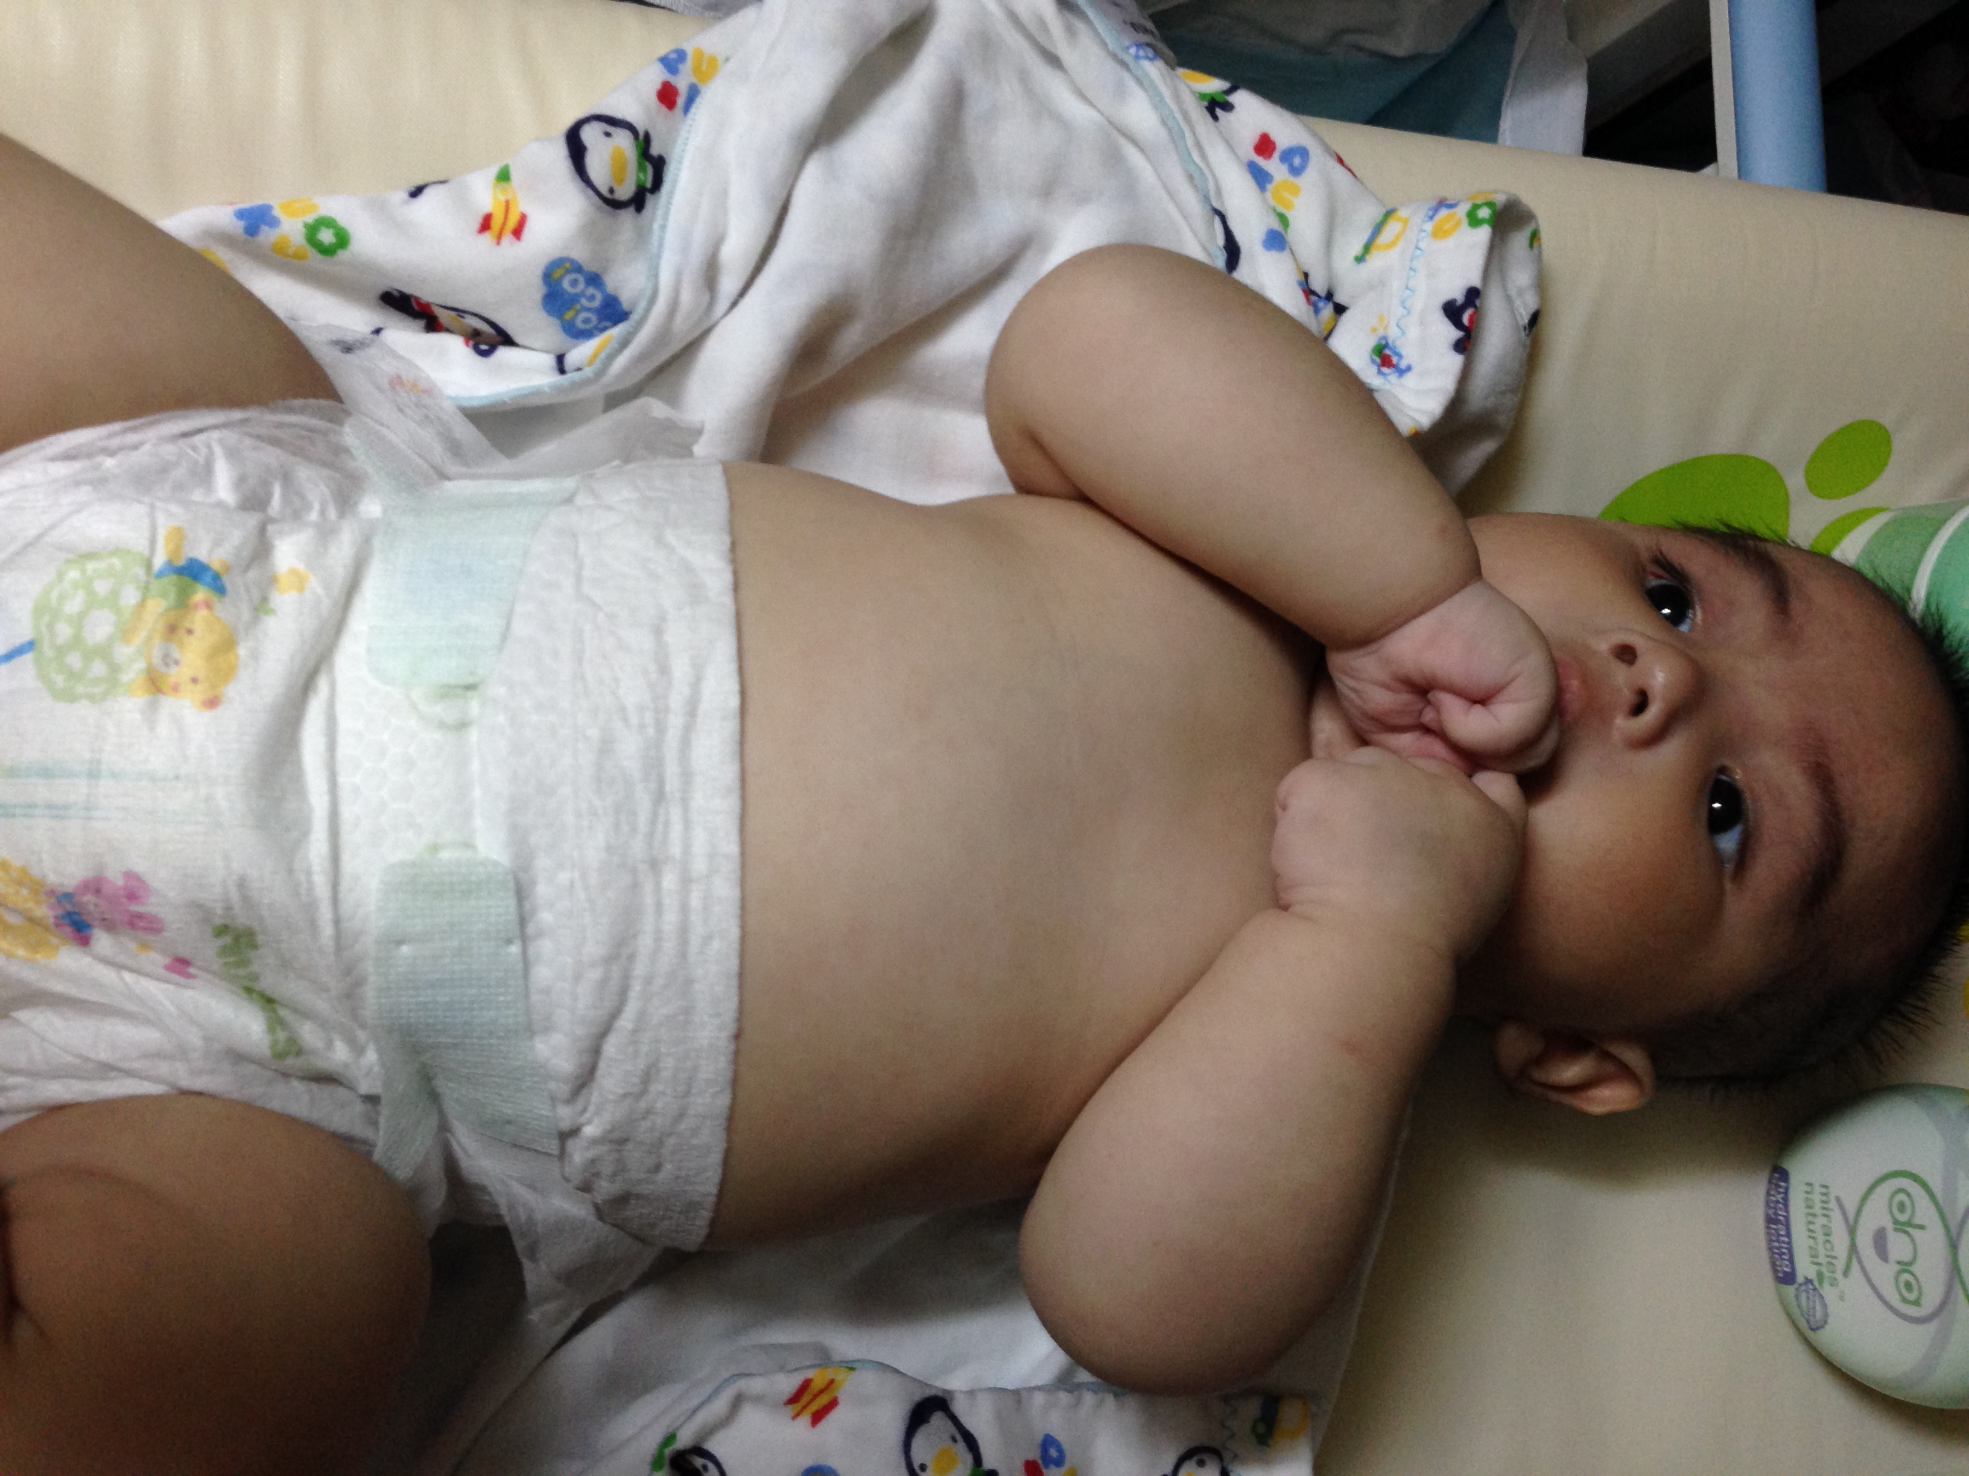

Slide 27
.
Notes:
27

